Slide 1


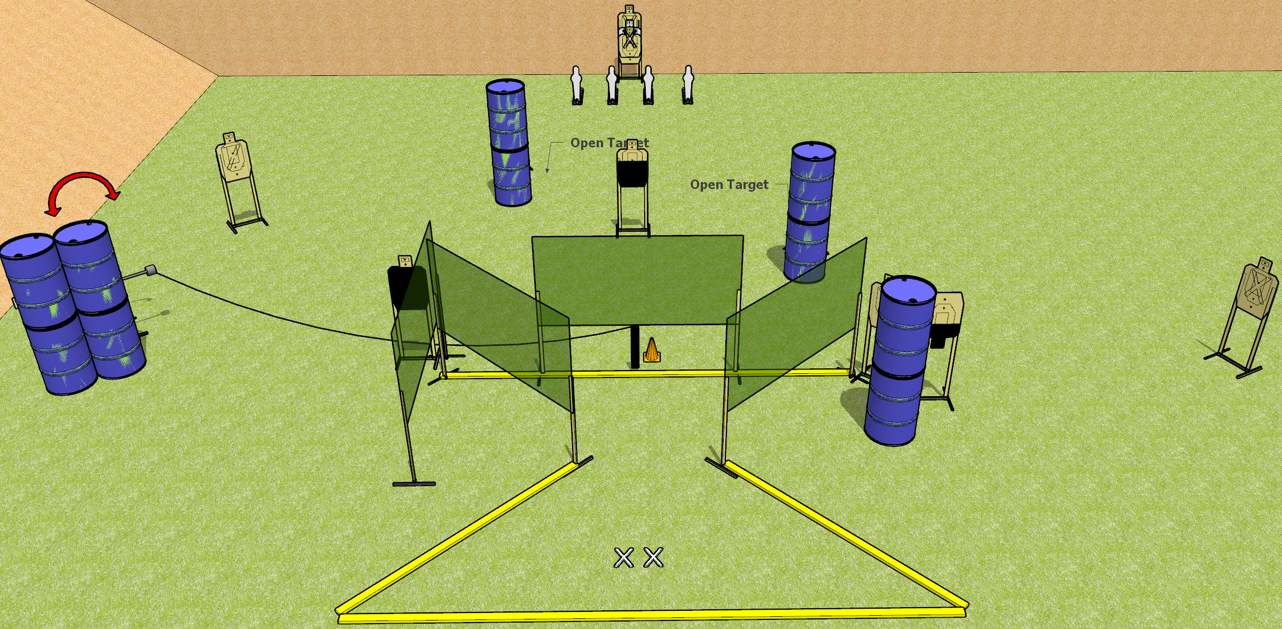
 | Dothan Gun Club – USPSA Match Ruffle Shuffle Course Designer : Drew Coleman
START POSITION : Standing with both feet on X’s, wrists below belt
GUN READY CONDITION : Pistol loaded and holstered. PCC loaded, shouldered, safety on, pointed at orange cone. |  | SCORING: Comstock, 26 rounds TARGETS: 11 paper, 4 Steel SCORED HITS: Best 2 on paper, steel until down START-STOP: Audible, last shot RULES:
STAGE PROCEDURE: Engage targets as they become available from within the fault lines.

Slide 2
Ruffle Shuffle
Written Stage Briefing
Ruffle Shuffle is a 26 rounds, 130 point, Comstock Field Course. There are eleven USPSA targets and four mini poppers. The best two hits per target will score. Steel must fall to score. The start signal is audible.
The handgun start position is both feet on X’s, gun loaded and holstered, wrists below belt.
The PCC start position is loaded carbine held with both hands, safety on, shouldered, muzzle pointed at orange cone.
Upon start signal, engage targets as they become available from within the fault lines.

